Slide 1
Rasoul Azarfarin
Prof. of Anesthesiology MD, FACC
Rajaie Cardiovascular Medical & Rearch Center
Dec 9 2017

Slide 2


Slide 3

Early Mobilisation
Page Title / heading goes here
Forms an integral component of the postoperative management of patients undergoing abdominal surgery
Accepted as routine postoperative practice in the 1940_{s}
Frequent and high quantities of early mobilisation have been associated with:
  Reductions in postoperative LOS
  Prevention of postoperative complications
  Prevention of functional decline
  Improved quality of life
Notes:
Early mobilisation forms an integral component of the postoperative management of patients undergoing UAS in current clinical practice
Early mobilisation has been practiced for quite a while, and was accepted as part of routine postoperative care in the 1940s
Within the literature, frequent and high quantities of early postoperative mobilisation have been associated with benefits such as: reductions in postoperative LOS, prevention of postoperative complications, prevention of functional decline and improvements in postoperative quality of life.
Therefore, it is considered important to get the patient upright and moving early after surgery

Slide 4
Why Early Mobility?
Benefits:
  Promote the maximal level of functional independence before discharge
  Decreased risk of neuromuscular abnormalities and physical impairments
  Decreased ventilator and hospital acquired diseases
  Decreased length of stay in the ICU and in the hospital Decreased duration of mechanical ventilation
  Decreased hospital costs
  Improved quality of life upon discharge
Notes:
Early mobility can be defined as PT evaluation and interventions being completed as soon as the interdisciplinary team believes it is appropriate and safe.
The dynamic interdisciplinary team at the University of Michigan is made up of physicians, physical therapists, respiratory therapists, nursing staff, and PT technicians.
The ultimate goal of an early mobility program is to promote the maximal level of functional independence before hospital discharge.
Neuromuscular weakness and physical impairments can lead to decreased quality of life after ICU admission.
By initiating an early mobility program into intensive care units throughout the country, research has shown several noted benefits:
improved functional status upon discharge
increased ambulation distance tolerance at discharge
decreased hospital and ventilator acquired diseases
decreased duration of mechanical ventilation
decreased hospital costs
and improved quality of life upon discharge

Slide 5
Cognition, Sleep, Pain Effects
ICU Delirium
Memory
Altered sleep-wake cycle
Back pain
Altered cutaneous pain perception
Notes:
Delirium is the commonest neuropsychiatric condition in hospital. It is seen throughout the hospital but mainly in the critical care units and in 80% in the sickest ventilated patient.
Memory, pain, altered sleep/wake cycles, and altered cutaneous pain perception is also present in immobilized patient’s on mechanical ventilation.

Slide 6
Aim of this study:
Postoperative cognitive disorders (POCD)
The prevalence of neurocognitive dysfunction after cardiac surgery varies between 30 to 70 percent.
Important known risk factors of post-op cognitive dysfunction:
  profound depth of anesthesia
  intraoperative decline of cerebral oxygenation
  continued low cardiac output,
  Patient age and education,
  previous neurologic and cognitive disorders.

Slide 7
Methods(1)
In a randomized controlled trial, 80 adult patients who had undergone elective cardiac surgery were randomly assigned to intervention:
[early mobilization protocol; (n=40)]
Control group [routine physical therapy; n=40]
Early mobilization started from the first post-op morning and continued until discharge from ICU.
Cognitive dysfunction was assessed by the Mini Mental State Examination (MMSE) questionnaire.
The MMSE questionnaire was completed at three occasions for every patient: one day before surgery, first post-op day, and the day before discharge from ICU.

Slide 8
Methods (2)
Ages of 20 to 70,
Ability to read and write
The patients must be cooperative (RASS between -2 and 2).
Exclusion criteria were as follows:
  Inability to communicate,
  Preexisting cognitive or psychological disorders,
  Cardiac arrest during or after cardiac surgery,
  Neurologic disturbance, and presence of severe visual or auditory dysfunction.
  Also presence of any contraindications for early mobilization would lead to exclusion;
    respiratory incompetence (need for FiO2 values more than 0.85 and PEEP equal to 15 cmH2o or more),
    acute myocardial ischemia,
    uncontrolled dysrhythmia,
    unstable blood pressure despite use of vasopressors,
    presence of open sternum

Slide 9
EMP (Early Mobilization Protocol)
Level 1 activity:
At this level, patient is totally dependent on assistance.
Hence, inactive movements in the patient’s ROM (Range of Motion) are applied twice daily ten times in each cycle, as well as head elevation over the bed (≥ 30◦) for 15 minutes and change of position for every 2 hours.
In a patient with RASS between -2 and +2 who tolerates level 1 activity, level 2 would be started.

Slide 10
Level 2 activity:
Active movements in patient’s ROM twice daily ten times in each cycle, head elevation over the bed (≥ 45◦) for 15 minutes
Applying sitting position for 15 minutes on the bed are parts of this level of activity.
If patient tolerates level 2 activity, then next level (level 3) could be started.

Slide 11
Level 3 activity:
At this patient needs moderate to low level of assistance.
Active movements in patient’s ROM twice daily ten times in each cycle, head elevation over the bed (≥ 45◦) for 15 minutes, applying sitting position for 15 minutes on the bed,
Sitting at the edge of the bed hanging feet with the aid of a nurse for 15 minutes are parts of this level of activity.
If patient tolerates level 3 activity, then level 4 could be applied.

Slide 12
Level 4 activity:
At this level, patient requires minimal assistance and nurse supervision would suffice for activities.
Active movements in patient’s ROM twice daily ten times in each cycle, head elevation over the bed (≥ 45◦) for 15 minutes, applying sitting position for 15 minutes on the bed, sitting at the edge of the bed and hanging feet with the aid of a nurse for 15 minutes,
Patient transport to the chair next to the bed by a nurse and
Restricted bedside walking or walking around the ward for stable patients, are parts of this level of activity.

Slide 13
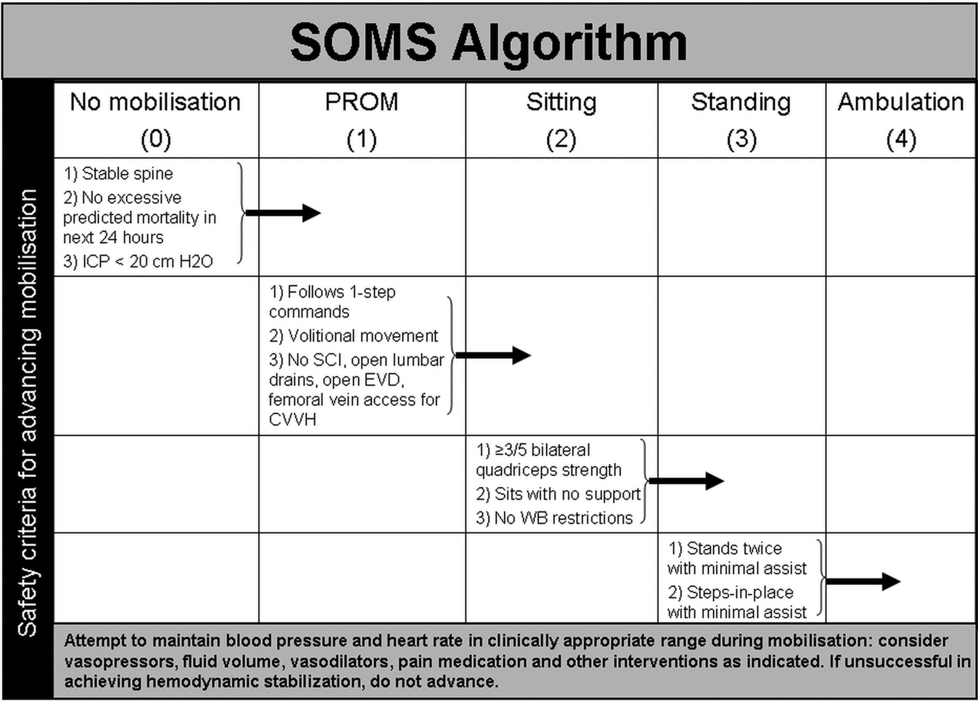

Slide 14
Control group:
No experimental protocol was implemented for the control group except for routine physiotherapy by a nurse physiotherapist.

Slide 15
Early Mobilization Protocol Algorithm
Highlights
Contraindications
Precautions
Signs of intolerance
PT/OT consult within 24 hours of admission
5 Levels based on RASS and functional status

Slide 17
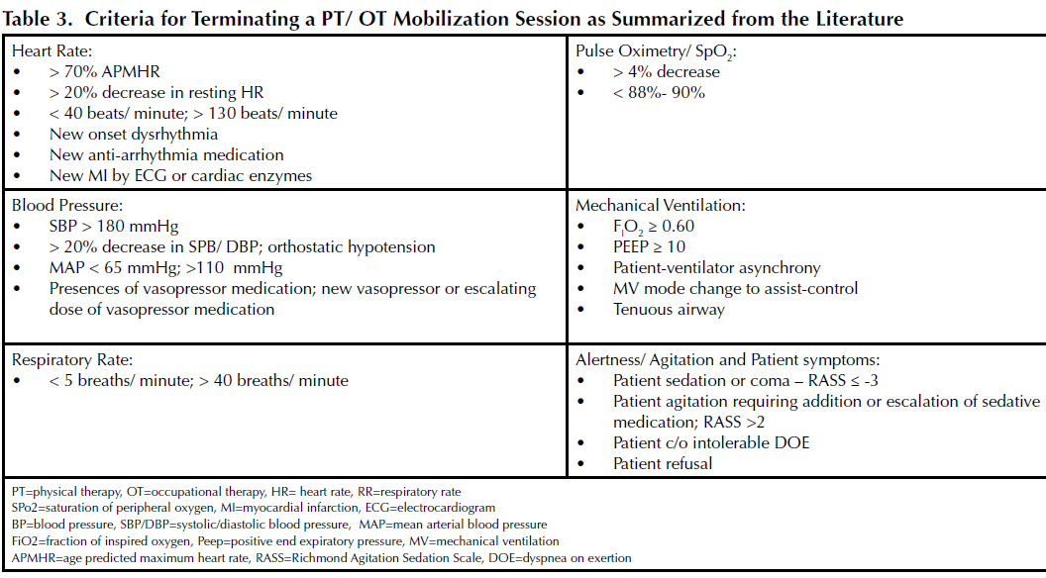

Slide 23
Conclusions:
Implementation of early mobilization protocol has positive effects on cognitive outcome and ICU stay after cardiac surgery.

Slide 24
Limitations
The sensitivity of the MMSE questionnaire to detect mild cases of dementia is low and leads to false negative diagnoses in people with higher education. In addition, low literacy may result in false positive findings.

Slide 25
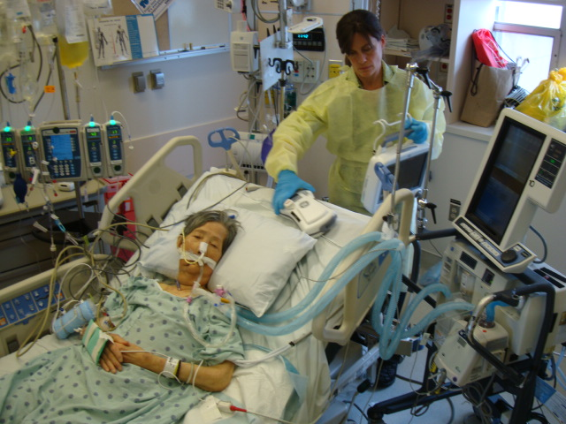
Step 1, untangling

Slide 26
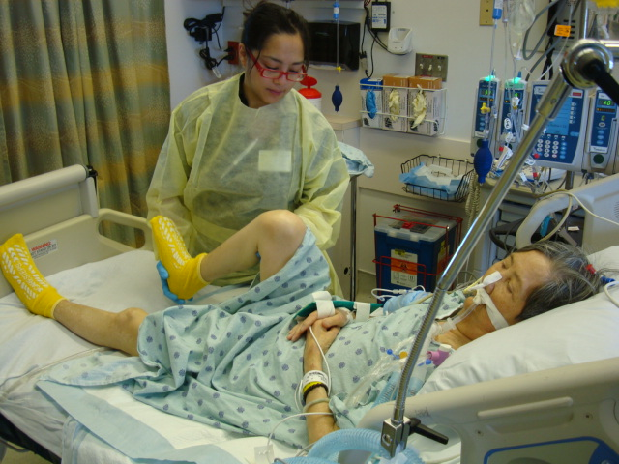
Step 2, Bed exercise

Slide 27
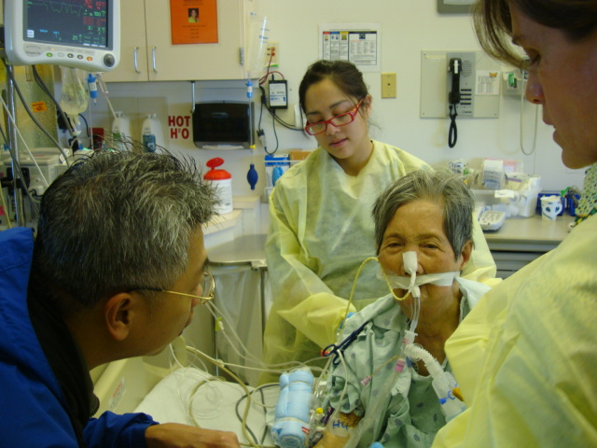
Step 3, sitting on Edge Of Bed

Slide 28
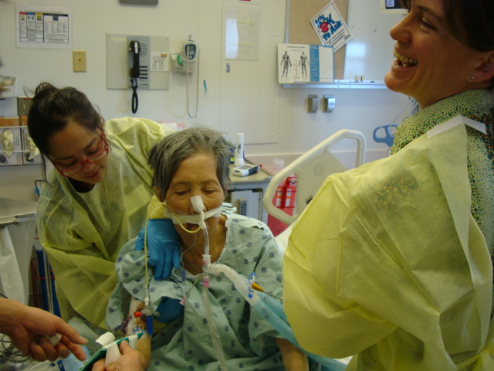
Step 4, assisted sit to stand

Slide 29
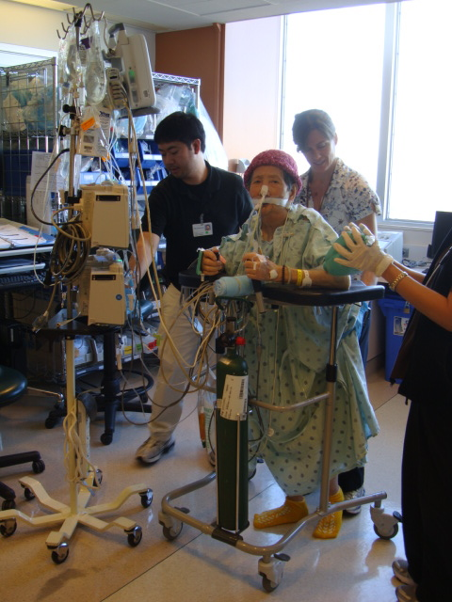
Step 5, walking

Slide 30
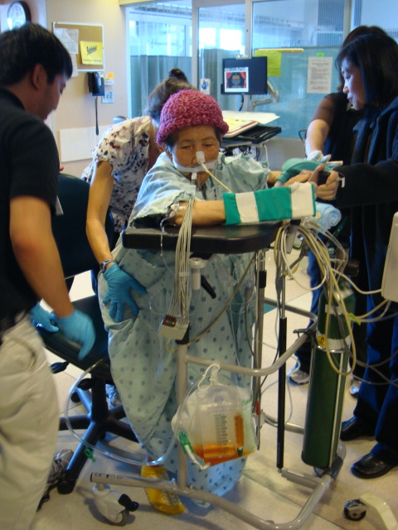
Step 6, sit and rest as needed

Slide 31
Barriers for Early Mobility
Need for a culture change
Perceived harm of mobilization
Subjective variations in decisions
Disagreement between care givers
Lack of structured algorithm
Excessive sedation
Lack of knowledge of the benefits
Lack of tools and trained staff
Notes:
Increased workload/ time constraints
Perception of patient’s readiness
Fear of fall or catheter/device integrity
Lack of education/ awareness
Lack of facilitator and mobility team

Slide 32
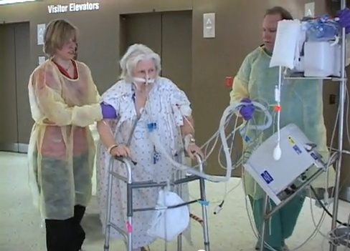
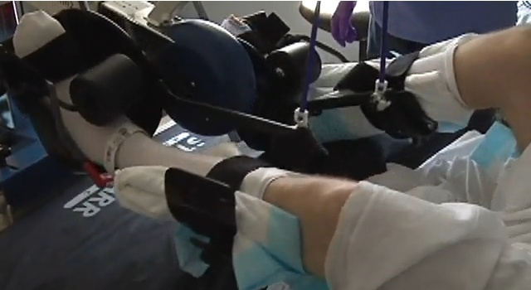
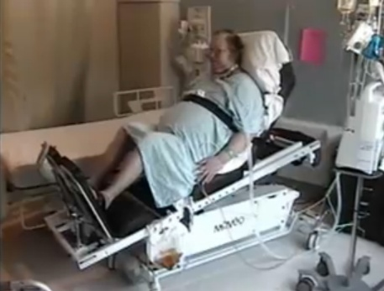
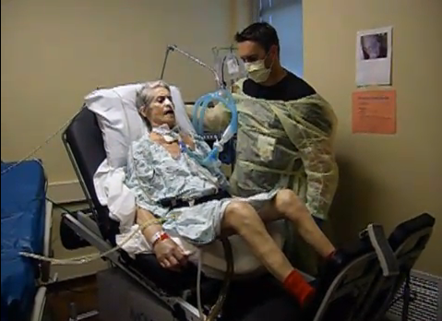
Future Trend

